Slide 1
Module 11: IPS Technologies
Networking Security v1.0
(NETSEC)
Notes:
Networking Security (NETSEC) Module 11: IPS Technologies

Slide 2
Module Objectives
Module Title: IPS Technologies
Module Objective: Explain how network-based Intrusion Prevention Systems are used to help secure a network.
Topic Title | Topic Objective
IDS and IPS Characteristics | Explain the functions and operations of IDS and IPS systems.
IPS Implementations | Explain how network-based IPS are implemented.
IPS on Cisco ISRs | Describe the IPS technologies that are available on Cisco ISR routers.
Cisco Switched Port Analyzer | Configure Cisco SPAN.
Notes:
2
11 – IPS Technologies
11.0.2 – What will I learn to do in this module?

Slide 3
11.1 IDS and IPS Characteristics
Notes:
11: IPS Technologies 11.1: IDS and IPS Characteristics

Slide 4
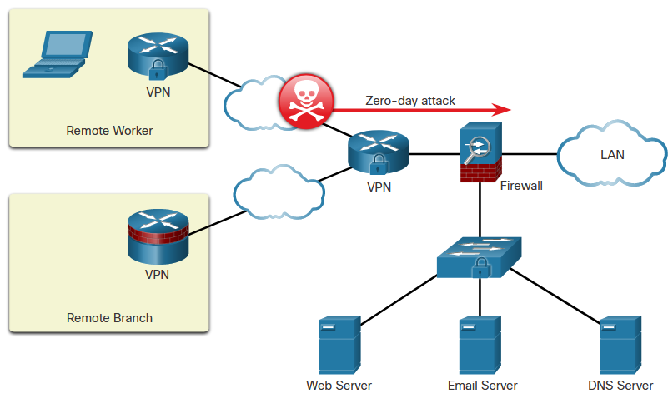
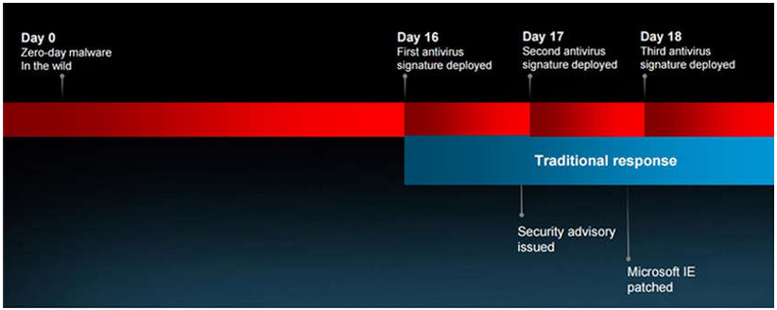
IDS and IPS Characteristics
Zero-Day Attacks
A zero-day attack is a cyberattack that tries to exploit software vulnerabilities that are unknown or undisclosed by the software vendor. The term zero-day describes the moment when a previously unknown threat is identified.
Microsoft Internet Explore Zero-Day Vulnerability
Notes:
11: IPS Technologies 11.1: IDS and IPS Characteristics 11.1.1: Zero-Day Attacks

Slide 5
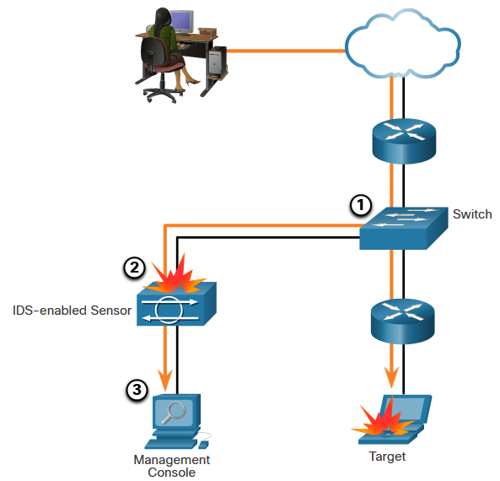
IDS and IPS Characteristics
Monitor for Attacks
Intrusion Detection Systems (IDS) were implemented to passively monitor the traffic on a network. The figure shows that an IDS-enabled device copies the traffic stream and analyzes the copied traffic rather than the actual forwarded packets. A better solution is to use a device that can immediately detect and stop an attack. An Intrusion Prevention System (IPS) performs this function.
Notes:
11: IPS Technologies 11.1: IDS and IPS Characteristics 11.1.2: Monitor for Attacks

Slide 6
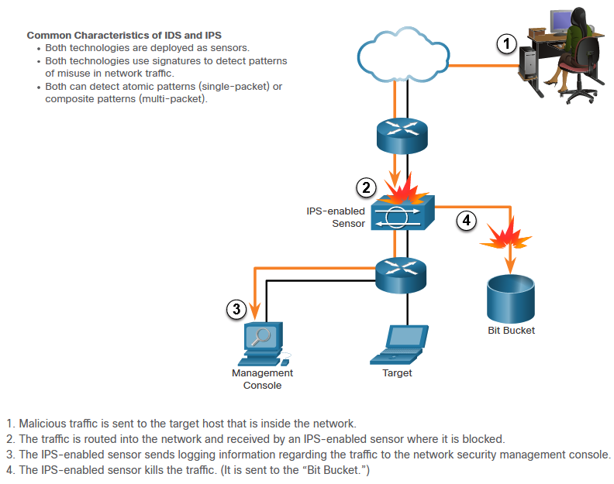
IDS and IPS Characteristics
Intrusion Prevention and Detection Devices
Notes:
11: IPS Technologies 11.1: IDS and IPS Characteristics 11.1.3: Intrusion Prevention and Detection Devices

Slide 7
IDS and IPS Characteristics
Advantages and Disadvantages of IDS and IPS
Solution | Advantages | Disadvantages
IDS | No Impact on network (latency, jitter) No Network impact if there is a sensor failure No network impact if there is sensor overload | Response action cannot stop trigger packets Correct tuning required for response actions More vulnerable to network security evasion techniques
IPS | Stops trigger packets Can use stream normalization techniques | Sensor issues might affect network traffic Sensor overloading impacts the network Some impact on network (latency, jitter)
Notes:
11: IPS Technologies 11.1: IDS and IPS Characteristics 11.1.4: Advantages and Disadvantages of IDS and IPS
11.1.5: Interactive Activity – Compare IDS and IPS Characteristics

Slide 8
11.2 IPS Implementations
Notes:
11: IPS Technologies 11.2: IPS Implementations

Slide 9
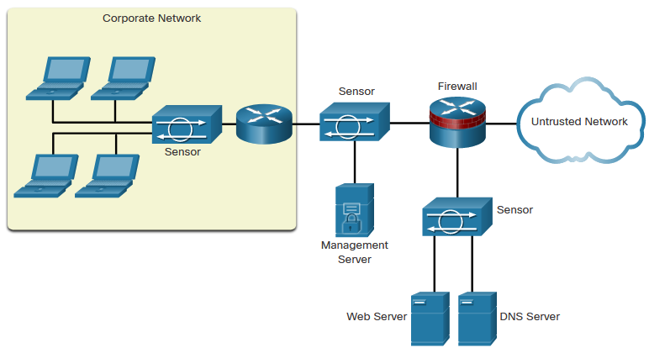
IPS Implementations
Types of IPS
There are two primary kinds of IPS available: host-based IPS (HIPS) and network-based IPS.
HIPS can be thought of as a combination of antivirus software, antimalware software, and a firewall. An example of a HIPS is Windows Defender. It provides a range of protection measures for Windows hosts.
A network-based IPS can be implemented using a dedicated or non-dedicated IPS device such as a router. Network-based IPS implementations are a critical component of intrusion prevention. Host-based IDS/IPS solutions must be integrated with a network-based IPS implementation to ensure a robust security architecture.
Sample IPS Sensor Deployment
Notes:
11: IPS Technologies 11.2: IPS Implementations 11.2.1: Types of IPS

Slide 10
IPS Implementations
Network-Based IPS
Network-based IPS Sensors can be implemented in several ways:
On a Cisco Firepower appliance
On an ASA firewall device
On an ISR router
As an NGIPSv for VMware
The hardware of all network-based sensors includes three components:
NIC - The network-based IPS must be able to connect to any network, such as Ethernet, Fast Ethernet, and Gigabit Ethernet.
Processor - Intrusion prevention requires CPU power to perform intrusion detection analysis and pattern matching.
Memory - Intrusion detection analysis is memory-intensive. Memory directly affects the ability of a network-based IPS to efficiently and accurately detect an attack.)
Notes:
11: IPS Technologies 11.2: IPS Implementations 11.2.2: Network-Based IPS

Slide 11

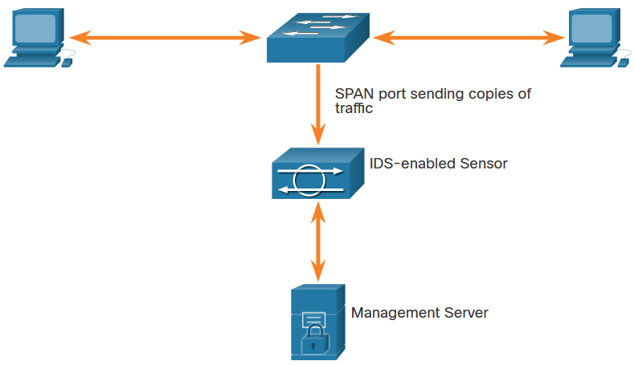
IPS Implementations
Modes of Deployment
Inline Mode
IDS and IPS sensors can operate in inline mode (also known as inline interface pair mode) or promiscuous mode (also known as passive mode).
Promiscuous
Mode
Notes:
11: IPS Technologies 11.2: IPS Implementations 11.2.3: Modes of Deployment
11.2.4: Check Your Understanding – Compare IDS and IPS Deployment

Slide 12
11.3 IPS on Cisco ISRs
Notes:
11: IPS Technologies 11.3: IPS on Cisco ISRs

Slide 13
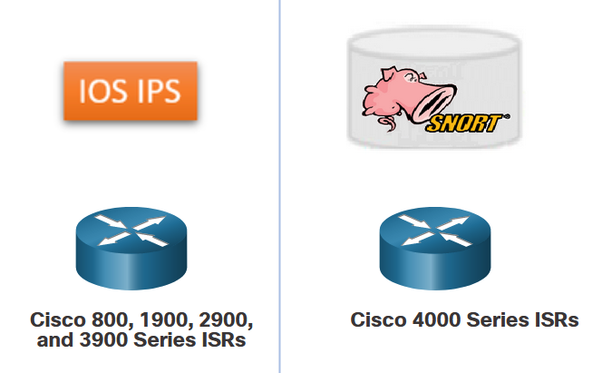
IPS on Cisco ISRs
IPS Components
The IPS detection and enforcement engine that can be implemented depends on the router platform:
Cisco IOS Intrusion Prevention System (IPS)
Cisco Snort IPS
An IPS sensor has two components:
IPS detection and enforcement engine - To validate traffic, the detection engine compares incoming traffic with known attack signatures that are included in the IPS attack signature package.
IPS attack signatures package - This is a list of known attack signatures that are contained in one file. The signature pack is updated frequently as new attacks are discovered. Network traffic is analyzed for matches to these signatures.
Notes:
11: IPS Technologies 11.3: IPS on Cisco ISRs 11.3.1: IPS Components

Slide 14
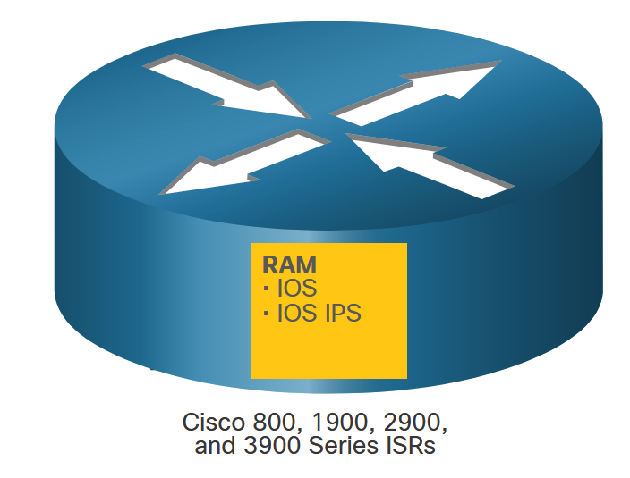
IPS on Cisco ISRs
Cisco IOS IPS
The network administrator could configure the Cisco IOS IPS to choose the appropriate response to various threats. For example, when packets in a session matched a signature, Cisco IOS IPS could be configured to respond as follows:
Send an alarm to a syslog server or a centralized management interface.
Drop the packet.
Reset the connection.
Deny traffic from the source IP address of the threat for a specified amount of time.
Deny traffic on the connection for which the signature was seen for a specified amount of time.
Notes:
11: IPS Technologies 11.3: IPS on Cisco ISRs 11.3.2: Cisco IOS IPS

Slide 15
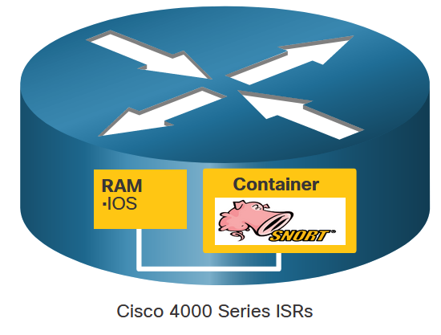
IPS on Cisco ISRs
Snort IPS
Many of the devices that supported Cisco IOS IPS are no longer available, or no longer supported. The newer Cisco 4000 Series Integrated Services Routers (ISR) provide IPS services using the Snort IPS feature. Snort is an open source network IPS that performs real-time traffic analysis and generates alerts when threats are detected on IP networks. It can also perform protocol analysis, content searching or matching, and detect a variety of attacks and probes, such as buffer overflows, stealth port scans, etc.
The Snort engine runs in a virtual service container on Cisco 4000 Series ISRs. A virtual service container is a virtual machine that runs on the ISR router operating system. Service containers are applications that can be hosted directly on Cisco IOS XE routing platforms. The Snort container is distributed as an Open Virtualization Appliance (OVA) file that is installed on the router.
Notes:
11: IPS Technologies 11.3: IPS on Cisco ISRs 11.3.3: Snort IPS

Slide 16
IPS on Cisco ISRs
Snort Operation
Snort IPS signatures are delivered automatically to the ISR by Cisco Talos. Snort can customize rule sets and provide centralized deployment and management capabilities for 4000 Series ISRs.
Snort can be enabled in IDS mode or IPS mode:
IDS mode - Snort inspects the traffic and reports alerts but does not take any action to prevent attacks.
IPS mode - In addition to intrusion detection, actions are taken to prevent attacks.
In the network intrusion detection and prevention mode, Snort performs the following actions:
Monitors network traffic and analyzes against a defined rule set.
Performs attack classification.
Invokes actions against matched rules.
Notes:
11: IPS Technologies 11.3: IPS on Cisco ISRs 11.3.4: Snort Operation

Slide 17
IPS on Cisco ISRs
Snort Features
The table lists the features and benefits of Snort IPS.
Feature | Benefit
Signature-based intrusion detection system (IDS) and intrusion prevention system (IPS) | Snort open-source IPS, capable of performing real-time traffic analysis and packet logging on IP networks, runs on the 4000 Series ISR service container without the need to deploy an additional device at the branch.
Snort rule set updates | Snort rule set updates for 4000 Series ISRs are generated by Cisco Talos, a group of leading-edge network security experts who work around the clock to proactively discover, assess, and respond to the latest trends in hacking activities, intrusion attempts, malware, and vulnerabilities.
Snort rule set pull | The router will be able to download rule sets directly from cisco.com or snort.org to a local server, using one-time commands or periodic automated updates.
Snort rule set push | A centralized management tool can push the rule sets based on preconfigured policy, instead of the router directly downloading on its own.
Signature allowed listing | Allowed listing allows the disabling of certain signatures from the rule set. Disabled signatures can be reenabled at any time.
Notes:
11: IPS Technologies 11.3: IPS on Cisco ISRs 11.3.5: Snort Features

Slide 18
IPS on Cisco ISRs
Snort System Requirements
A security K9 license (SEC) is required to activate Snort IPS functionality. Customers also need to purchase a yearly subscription for the signature package distributed on cisco.com. To keep current with the latest threat protection, Snort rule sets are term-based subscriptions, available for one or three years.
There are two types of term-based subscriptions:
Community Rule Set - Offers limited coverage against threats, focusing on reactive response to security threats versus proactive research work. There is 30-day delayed access to updated signatures in the Community Rule Set, and this subscription does not entitle the customer to Cisco support.
Subscriber Rule Set - Offers the best protection against threats. It includes coverage in advance of exploits by using the research work of the Cisco Talos security experts. The Subscriber Rule Set also provides the fastest access to updated signatures in response to a security incident or the proactive discovery of a new threat. This subscription is fully supported by Cisco.
Notes:
11: IPS Technologies 11.3: IPS on Cisco ISRs 11.3.6: Snort System Requirements
11.3.7: Check Your Understanding – IPS on Cisco ISRs

Slide 19
11.4 Cisco Switched Port Analyzer
Notes:
11: IPS Technologies 11.4: Cisco Switched Port Analyzer

Slide 20
Cisco Switched Port Analyzer
Network Monitoring Methods
The day-to-day operation of a network consists of common patterns of traffic flow, bandwidth usage, and resource access. Together, these patterns identify normal network behavior. Security analysts must be intimately familiar with normal network behavior because abnormal network behavior typically indicates a problem.
To determine normal network behavior, network monitoring must be implemented using IDS, packet analyzers, SNMP, NetFlow, and other tools. Some of these tools require captured network data. There are two common methods used to capture traffic and send it to network monitoring devices:
Network taps, sometimes known as test access points (TAPs)
Traffic mirroring using Switch Port Analyzer (SPAN) or other port mirroring approaches.
Notes:
11: IPS Technologies 11.4: Cisco Switched Port Analyzer 11.4.1: Network Monitoring Methods

Slide 21
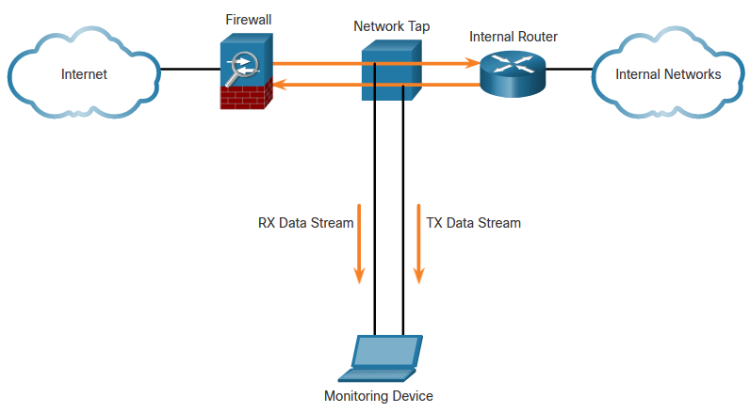
Cisco Switched Port Analyzer
Network Taps
A network tap is typically a passive splitting device implemented inline between a device of interest and the network. A tap forwards all traffic, including physical layer errors, to an analysis device while also allowing the traffic to reach its intended destination. Taps are also typically fail-safe, which means if a tap fails or loses power, traffic between the firewall and internal router is not affected.
Notes:
11: IPS Technologies 11.4: Cisco Switched Port Analyzer 11.4.2: Network Taps

Slide 22
Cisco Switched Port Analyzer
Traffic Mirroring and SPAN
Because capturing data for network monitoring requires all traffic to be captured, special techniques must be employed to bypass the network segmentation imposed by network switches. Port mirroring is one of these techniques. Port mirroring enables the switch to copy frames that are received on one or more ports to a Switch Port Analyzer (SPAN) port that is connected to an analysis device.
The table identifies and describes terms used by the SPAN feature.
SPAN Term | Description
Ingress traffic | Traffic that enters the switch.
Egress traffic | Traffic that leaves the switch.
Source (SPAN) port | Source ports are monitored as traffic entering them is replicated (mirrored) to the destination ports.
Destination (SPAN) port | A port that mirrors source ports. Destination SPAN ports often connect to analysis devices such as a packet analyzer or an IDS.
Notes:
11: IPS Technologies 11.4: Cisco Switched Port Analyzer 11.4.3: Traffic Mirroring and SPAN

Slide 23
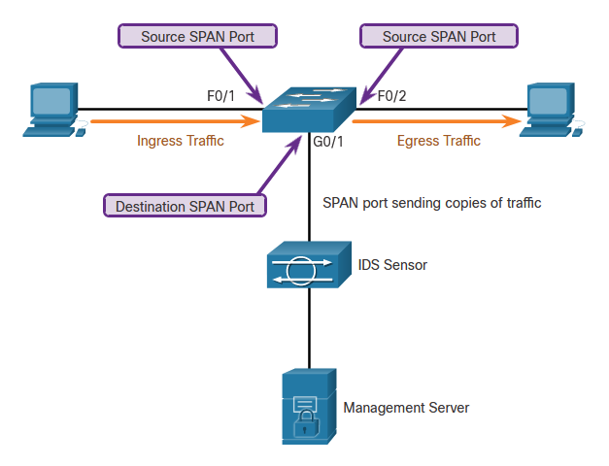
Cisco Switched Port Analyzer
Traffic Mirroring and SPAN (Cont.)
The figure shows a switch that interconnects two hosts and mirrors traffic to an intrusion detection device (IDS) and network management server.
Notes:
11: IPS Technologies 11.4: Cisco Switched Port Analyzer 11.4.3: Traffic Mirroring and SPAN(Cont.)

Slide 24
Cisco Switched Port Analyzer
Configure Cisco SPAN
The SPAN feature on Cisco switches sends a copy of each frame entering the source port out the destination port and toward the packet analyzer or IDS. A session number is used to identify a SPAN session. The figure shows the monitor session command, used to associate a source port and a destination port with a SPAN session. A VLAN can be specified instead of a physical port.
Notes:
11: IPS Technologies 11.4: Cisco Switched Port Analyzer 11.4.4: Configure Cisco SPAN using Intrusion Detection
11.4.5: Syntax Checker – Configure and Verify SPAN

Slide 25
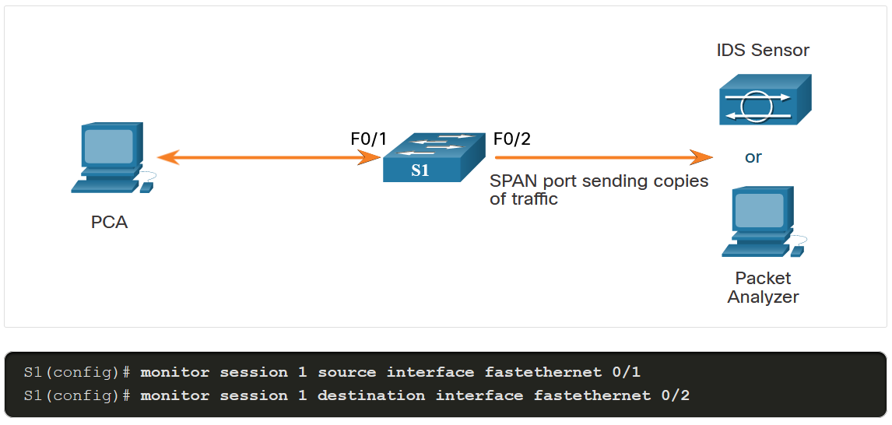
Cisco Switched Port Analyzer
Configure Cisco SPAN (cont.)
In this example, PCA is connected to F0/1 and an IDS is connected to F0/2. The objective is to capture all the traffic that is sent or received by PCA on port F0/1 and send a copy of those frames to the IDS (or a packet analyzer) on port F0/2. The SPAN session on the switch will copy all the traffic that it sends and receives on source port F0/1 to the destination port F0/2.
Notes:
11: IPS Technologies 11.4: Cisco Switched Port Analyzer 11.4.4: Configure Cisco SPAN using Intrusion Detection
11.4.5: Syntax Checker – Configure and Verify SPAN

Slide 26
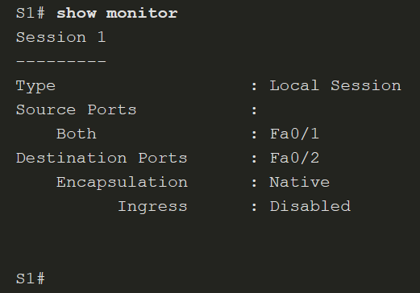
Cisco Switched Port Analyzer
Configure Cisco SPAN (cont.)
The show monitor command is used to verify the SPAN session.
Notes:
11: IPS Technologies 11.4: Cisco Switched Port Analyzer 11.4.4: Configure Cisco SPAN using Intrusion Detection
11.4.5: Syntax Checker – Configure and Verify SPAN

Slide 27
Cisco Switched Port Analyzer
Packet Tracer - Implement a Local SPAN
In this Packet Tracer, you will complete the following objectives:
Part 1: Build the Network and Verify Connectivity
Part 2: Configure Local SPAN and Capture Copied Traffic with Wireshark
Notes:
11: IPS Technologies 11.4: Cisco Switched Port Analyzer 11.4.6: Packet tracer - Implementing a Local SPAN

